Slide 1
CMSC 426 Principles of Computer Security
Introduction

Slide 2
Today’s Topics
Course Information and Syllabus
Grading Scheme
Academic Integrity
Security Objectives
CIA Triad
Avenues of Attack

Slide 3
Introductions
Dr. Katherine Gibson
Education
BS in Computer Science, UMBC
MS & PhD in CS, University of Pennsylvania
Likes
Dogs
Video Games
Nail polish
Favorite CS topics:
Pointers
Makefiles
Why Java sucks

Slide 4
What the Course is About
Principles of Computer Security
A broad overview of a variety of security topics
Threat, attack, and adversary models
Essentials of cryptography
Computing security models
Network and database security
Malware
Secure programming
OS security
Legal and ethical issues

Slide 5
Course Resources
Blackboard
For announcements, turning in assignments, receiving grades
Has link to website and Piazza on sidebar
Website
Has information on schedule, assignments, exam info, office hours
Where lecture slides will be posted
Piazza
For asking/answering questions, forming groups, etc.

Slide 6
Grading Scheme
This class has
4 Labs (100 points each)
Large, hands-on assignments
5 Homeworks (20 points each)
Small, theory and application-based assignments
5 Papers (10 points each)
Short papers done in small groups
Response papers, summary papers, etc.
3 Exams (150 points each)
Non-comprehensive exams

Slide 7
Submission and Late Policy
Most assignments will be submitted via Blackboard
Assignments are due Wednesdays at midnight (11:59:59 PM)
Late assignments receive a zero
In other words, there are no late assignments
Extensions may be granted, but only for actual emergencies
Submit early, submit often

Slide 8
Academic Integrity

Slide 9
General Rules
Don’t copy someone else’s work
Don’t leave your work unprotected
Don’t post your code online
Don’t pay someone else to do your work
Automatic F in the course
Come to office hours or Piazza for help
Don’t be stupid (please)

Slide 10
Using Online Resources
You’re allowed to use Google, Stack Overflow, etc.
Provided it does not comprise a significant portion of your submission
If you use resources (outside of the course slides/book), you must cite their use:
Where you found the information
What the code does/how the explanation applies/etc.
Whether it was copied, adapted, or only provided inspiration

Slide 11
Introduction to Security

Slide 12
Security Objectives: The CIA Triad
There are three key objectives in computer security:
Confidentiality
Data is not available to unauthorized persons/systems
Users have control over their information and who sees it
Integrity
Accuracy and completeness of data is assured
System performs functions unimpeded
Availability
System, information, and means of access are kept in working order and function correctly
Integrity
Availability
Confidentiality

Slide 13
Additional Objectives
Authenticity
Users and data can be verified to be genuine and therefore trusted
Accountability
Actions (like security breaches and false data) can be traced to their source or origin
Non-repudiation
Users cannot deny their involvement in sending/receiving data
Legal term; encompasses the system as a whole
Why does this matter?

Slide 14
Accountability for an Imperfect World
Security protocols and systems can fail and be breached
Security protocols and systems will fail and be breached
Need to be able to trace failures and breaches to their source
Origins and destinations of sent data
Which users access what data and when
Ideally, detect and report intrusion when it happens (instead of when someone notices a problem later)

Slide 15
Avenues of Attack
Computer systems have multiple avenues of attack
Software
Hardware
Networks
Physical
Human/Social
Insider attack
Passive attack
“Acoustic Side-Channel Attacks on Printers”
Phishing emails, phone scams, oversharing

Slide 16
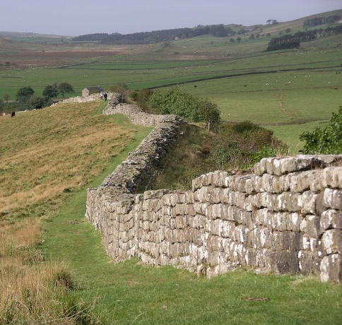
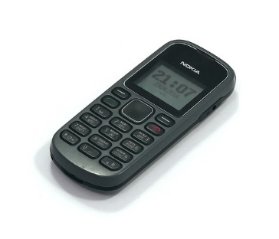
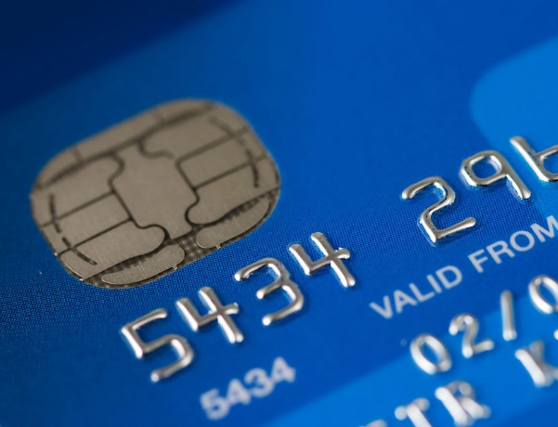
Exercise: Security Examples
How do each of the following examples measure up in terms of confidentiality, integrity, and availability?
What avenues of attack are applicable for each?
Walls Wax seals Burner phones Credit cards

Slide 17
Daily Security Tidbit
DEFCON Voting Machine Hacking Village
25 (paperless electronic) voting machines and 13 imitation websites were made available for physical probing and hacking attempts
Problems: plain text password storage, expired certificates, easily-breakable physical locks, “password” as a password, etc.
11-year-olds hacked the Florida website in under 15 minutes
A 17-year-old took down the entire website by writing down the IP address and googling MySQL commands for five minutes
Another hacker played gifs and music by uploading a Linux OS

Slide 18
Announcements
We will be meeting on Tuesday
Enjoy the long weekend!
Course website will update with a more detailed schedule of topics and assignment due dates

Slide 19
Image Sources
Penrose triangle (adapted from):
https://pixabay.com/en/optical-illusion-illusion-triangle-154081/
Hadrian’s wall (adapted from):
https://commons.wikimedia.org/wiki/File:Hadrian%27s_wall_at_Greenhead_Lough.jpg
Wax seal:
https://www.flickr.com/photos/artistmam/4245651173/
Burner phone:
https://pixabay.com/en/nokia-1280-cell-phone-mobile-1502601/
Credit card:
http://www.freestockphotos.biz/stockphoto/8210

